Slide 1
Rearrange
By: Simon Wroblewski, Riley Persily, Andrew Arteaga

Slide 2
Topic: New Syscall Rearrange
Goal:
Provide the ability to use a command to receive a list of the current priorities and then rearrange them to the user’s desire.
Users will then be able to select a process by entering the process ID and choosing a new place in the list of priority.
Integrate and expand upon the functionality of `top`

Slide 3
Kernel Struggles: The Good, The Bad, and The Ugly
The Bad:
There is no standardized way of building a kernel
It was hard for the group to pinpoint what was wrong when each build failed
The Ugly:
Hard to install and integrate
Kernel panics and not allocating enough memory forced us to rebuild the kernel multiple times
The Good:
Learning experience, made us better programmers
Learned how to use linux

Slide 4
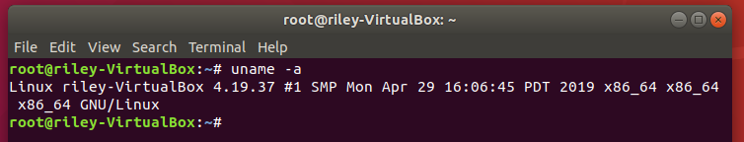
Attempting to build the Kernel
Numerous Attempts to build
Crashed during compile due to insufficient amount of storage and memory
New VM, able to compile and then build successfully

Slide 5
New Modification: Randomize Renice
Using a simple random number generator, hoped to create a new version of renice that will randomize the priority assigned to the desired process
Add “-r” option

Slide 6
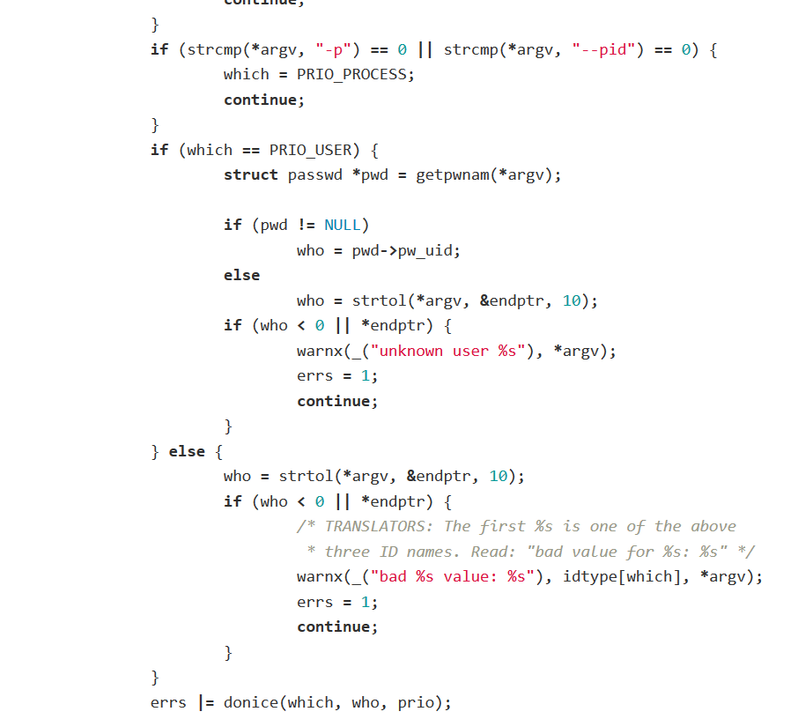

Slide 7
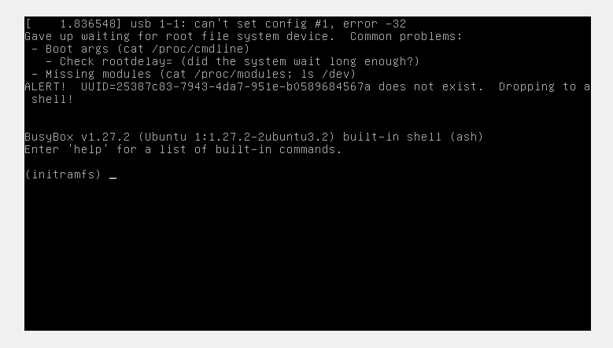
Build Failed
After finding the original renice, modified the code
Followed the steps to insert new syscall into kernel
Compiled and attempted to install
Crashed on restart

Slide 8
End Result: Failure
After multiple attempts of trying to implement the modification, we failed to produce a working kernel.
Still learned a lot this semester.
Thanks for the semester professor!

